Slide 1
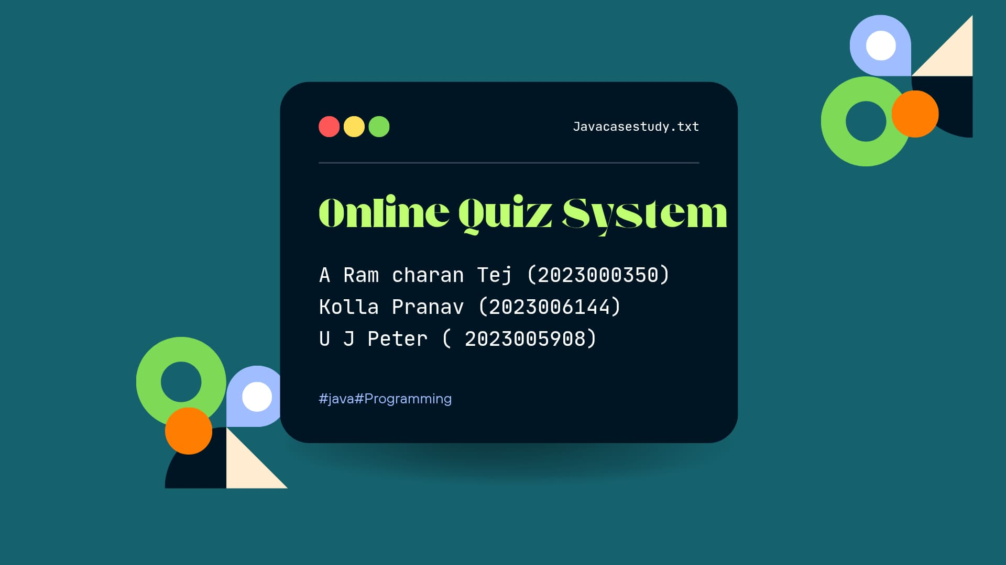

Slide 2
import java.util.*;
// Interface for scoring
interface Scorable {
int calculateScore();
public static void main(String[] args) {
OnlineQuizSystem.main(args);
}
}
// Abstract class for User
abstract class User {
protected int userId;
protected String name, email;
protected String password;
public User(int userId, String name, String email, String password) {
this.userId = userId;
this.name = name;
this.email = email;
this.password = password;

Slide 3
}
public boolean login(String email, String password) {
if (this.email.equals(email) && this.password.equals(password)) {
System.out.println(name + " logged in successfully.");
return true;
} else {
System.out.println("Invalid login credentials.");
return false;
}
}
}
// Student class
class Student extends User {
private List<Integer> quizScores;
public Student(int userId, String name, String email, String password) {
super(userId, name, email, password);
this.quizScores = new ArrayList<>();
}

Slide 4
public void attemptQuiz(Quiz quiz, Scanner scanner) {
System.out.print("Enter quiz password: ");
String enteredPassword = scanner.nextLine();
if (quiz.validatePassword(enteredPassword)) {
int score = quiz.startQuiz();
quizScores.add(score);
} else {
System.out.println("Incorrect quiz password. Access denied.");
}
}
}
// Admin class
class Admin extends User {
public Admin(int userId, String name, String email, String password) {
super(userId, name, email, password);
}
public void createQuiz(Quiz quiz) {
System.out.println("Quiz \"" + quiz.getTitle() + "\" created.");

Slide 5
}
}
// Quiz class
class Quiz implements Scorable {
private String title;
private List<Question> questions;
private int timeLimit;
private Scanner scanner;
private String quizPassword;
public Quiz(String title, int timeLimit, Scanner scanner, String quizPassword) {
this.title = title;
this.questions = new ArrayList<>();
this.timeLimit = timeLimit;
this.scanner = scanner;
this.quizPassword = quizPassword;
}
public String getTitle() {
return title;
}

Slide 6
public void addQuestion(Question question) {
questions.add(question);
}
public boolean validatePassword(String enteredPassword) {
return quizPassword.equals(enteredPassword);
}
public int startQuiz() {
int score = 0;
long startTime = System.currentTimeMillis();
Collections.shuffle(questions);
System.out.println("\nStarting Quiz: " + title + " (Time Limit: " + timeLimit + " sec)");
for (Question q : questions) {
q.displayQuestion();
System.out.print("Your answer: ");
String userAnswer = scanner.nextLine();

Slide 7
if (q.checkAnswer(userAnswer)) {
score++;
}
if ((System.currentTimeMillis() - startTime) / 1000 > timeLimit) {
System.out.println("Time's up!");
break;
}
}
System.out.println("\nQuiz Completed! Your Score: " + score + "/" + questions.size());
return score;
}
@Override
public int calculateScore() {
return questions.size();
}
}

Slide 8
// Abstract Question class
abstract class Question {
protected String text;
public Question(String text) {
this.text = text;
}
public abstract void displayQuestion();
public abstract boolean checkAnswer(String answer);
}
// Multiple Choice Question
class MultipleChoiceQuestion extends Question {
private List<String> options;
private String correctAnswer;
public MultipleChoiceQuestion(String text, List<String> options, String correctAnswer) {
super(text);
this.options = options;

Slide 9
this.correctAnswer = correctAnswer;
}
@Override
public void displayQuestion() {
System.out.println("\n" + text);
for (int i = 0; i < options.size(); i++) {
System.out.println((i + 1) + ". " + options.get(i));
}
}
@Override
public boolean checkAnswer(String answer) {
return options.get(Integer.parseInt(answer) - 1).equalsIgnoreCase(correctAnswer);
}
}

Slide 10
// Main class
public class OnlineQuizSystem {
public static void main(String[] args) {
Scanner scanner = new Scanner(System.in);
// Create Admin
Admin admin = new Admin(1, "Admin1", "admin@example.com", "adminpass");
admin.login("admin@example.com", "adminpass");
// Create Quiz with password
Quiz quiz = new Quiz("Java Basics", 30, scanner, "quiz123");
quiz.addQuestion(new MultipleChoiceQuestion("Which language is used for Android development?",
Arrays.asList("Java", "C++", "Python", "JavaScript"), "Java"));
admin.createQuiz(quiz);
// Create Student
Student student = new Student(2, "Ram Charan", "charan@example.com", "studentpass");
student.login("charan@example.com", "studentpass");

Slide 11
// Student attempts quiz
student.attemptQuiz(quiz, scanner);
scanner.close();
}
}

Slide 12
THANKS

